Slide 1
FLN AAT
Emotion analysis from facial expressions
using deep learning
-Meghana Joshi
(1BM17CS146)

Slide 2
CONTENTS
Abstract
Introduction
Related Work
Experimental Results
Conclusion

Slide 3
ABSTRACT
Automatic facial expression recognition - evolving study in the field of Emotion Recognition
How to enhance Convolutional Neural Network method to recognize 6 basic emotions
Evaluate pre-processing methods to show its influences on the performance:
-resizing -standard deviation
- mean -edge detection
- normalization - scaling

Slide 4
INTRODUCTION
Emotion recognition can simply be expressed as the process of identifying human emotion
Image Acquisition and Pre-processing
Image feature extraction
Classification

Slide 5
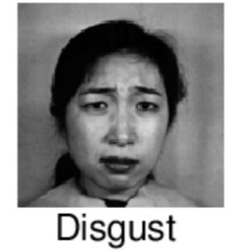
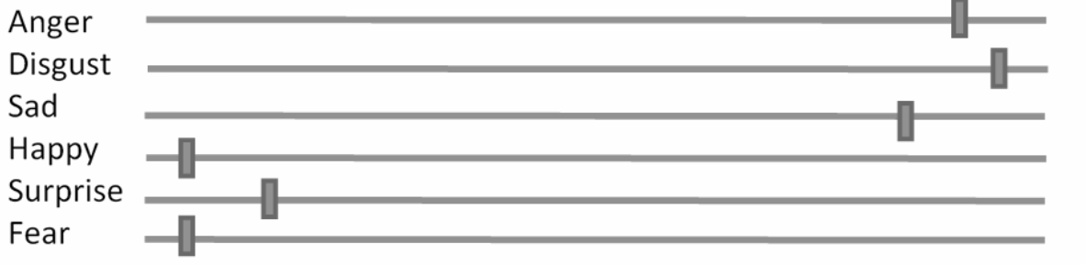
INTRODUCTION
Emotion recognition can simply be expressed as the process of identifying human emotion
6 Basic emotions: Sadness, Happiness, Anger, Disgust, Fear and Surprise
“Stop it! It’s disgusting!”

Slide 6
RELATED WORK
01
RESEARCH RELATED STUDIES
02
PROPOSED SYSTEM
03
RESEARCH METHODOLOGY
a
DATA SETS
b
PRE PROCESSING
c
CONVOLUTIONAL NEURAL NETWORKS

Slide 7
RESEARCH RELATED STUDIES
Local binary patterns (LBP) as the appearance-based feature extraction and drew distinctions between the various types of image resolution
According to the authors of Facial expression recognition with CNN, there is a single solution for facial expression recognition which uses a combination of Convolutional Neural Networks and specific image pre-processing steps
First, the data is pre-processed after which it is balanced using the following classifier models - Decision Tree (DT), Multilayer perceptron (MLP), Convolutional Neural Network (CNN).

Slide 8
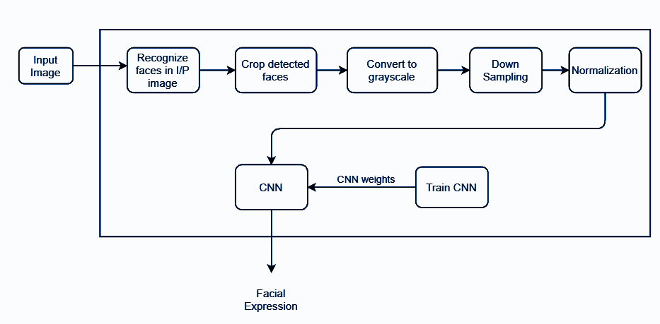
PROPOSED SYSTEM

Slide 9
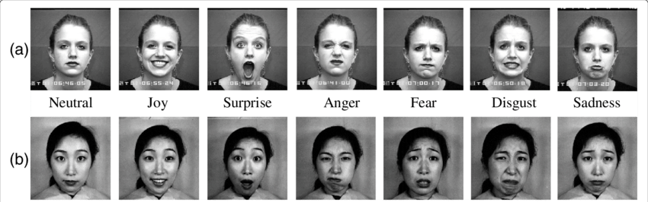
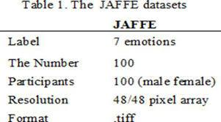
RESEARCH METHODOLOGY
DATA SETS
JAFFE -
100 images that represent some basic emotions from male and females
Gray scale images of faces in 48 x 48 pixel
Ultimate goal is to categorize each face based on the emotion shown in the facial expression into one of six categories

Slide 10
RESEARCH METHODOLOGY
DATA SETS
JAFFE
We categorise each image based on two columns- “emotion” and “pixels”.
“Emotion” - numeric code (0-6)
“Pixels”- string surrounded in quotes for each image - array of 2304 pixel values
Task is to predict “emotion ” column

Slide 11
RESEARCH METHODOLOGY
PREPROCESSING
Image pre-processing is the study of algorithms which take an image as input and give a vector(features) or image(matrix) as output
01
Resizing
02
Scaling
03
Mean
04
Standard Deviation
05
Normalization
06
Edge Detection

Slide 12
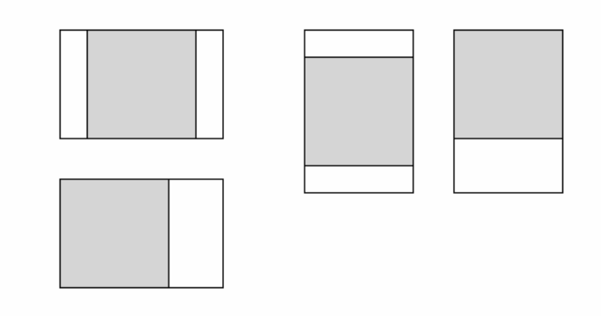
RESEARCH METHODOLOGY
PREPROCESSING
Resizing
An image will be adjusted to determine width, height and converted to gray scale image during the process of resizing.
Example:
Before resizing (1920, 1080)
After resizing (888, 500)

Slide 13
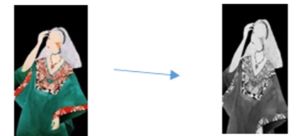
RESEARCH METHODOLOGY
PREPROCESSING
Scaling
While scaling an image, a new image with a higher or lower number of pixels must be generated.

Slide 14
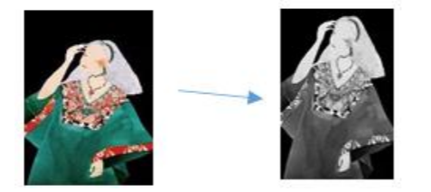
RESEARCH METHODOLOGY
PREPROCESSING
Mean
This method is used to reduce the amount of intensity variation between one pixel and the other. It is often used to reduce noise in images.

Slide 15
RESEARCH METHODOLOGY
PREPROCESSING
Standard Deviation
When we process an image with standard deviation, it will show the variance which is nearer or farther to the mean value of the given image.

Slide 16
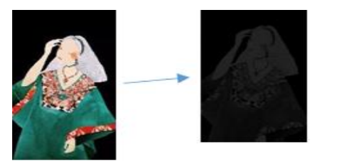
RESEARCH METHODOLOGY
PREPROCESSING
Normalization
It is a process that changes the range of pixel intensity values in images with poor contrast due to glare. It is also called contrast stretching.

Slide 17
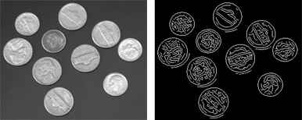
RESEARCH METHODOLOGY
PREPROCESSING
Edge Detection
The process of image detection involves detecting sharp edges in the image. This edge detection is essential in object detection.

Slide 18
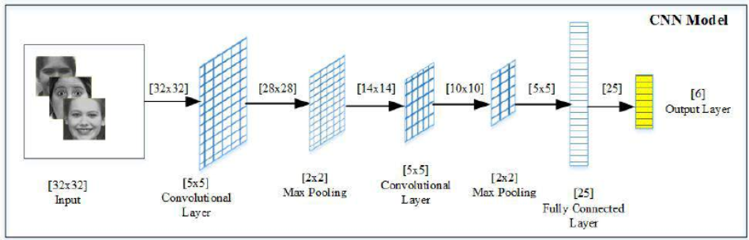
RESEARCH METHODOLOGY
CONVOLUTIONAL NEURAL NETWORKS
The role of the CNN is to reduce the images into a form which is easier to process, without losing features which are critical for getting a good prediction.

Slide 19
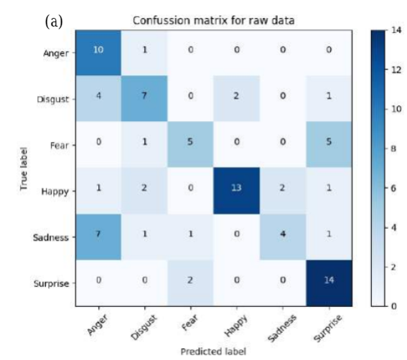
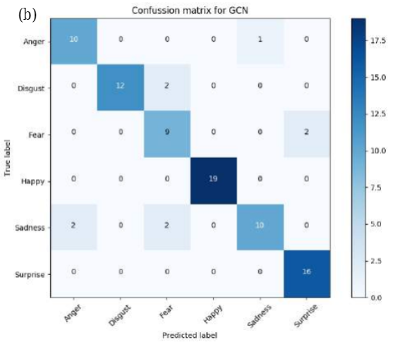
RESULTS

Slide 20
CONCLUSION
Proposed pre-processing methods can assist the CNN model to gain the higher accuracy rate in the applications of facial image processing
We can boost the performance of CNN using data augmentation

Slide 21
THANK YOU!

